Slide 1





FLIGHT XI
W261 Final Project In-Class Update – Group 11 – March 29, 2022
Jeff Adams, Jenny Conde, Dante Malagrino, Joy Moglia, Ram Senthamarai
Notes:
[JOY]
-Hi, we’re Flight XI, a predictive analytics startup serving the airline industry.
-The company was recently founded by myself, Joy, along with my co-founders Jeff, Jenny, Dante and Ram
-

Slide 2
OUTLINE
Dataset
Data Wrangling
Business Problem
Model & Results
Conclusions & Next Steps
01
02
03
04
05
Notes:
[JOY]
Today we will discuss the business problem we are trying to solve using machine learning, the data we are using to train our model, and what we’ve learned and accomplished so far

Slide 3
BUSINESS PROBLEM
Predict a 15-min or longer departure delay, given information available 2 hours before the scheduled departure
Notes:
[JOY]
Flight delay is a serious and widespread problem.
It places a significant strain on the air travel system, costing the US airline industry tens of billions of dollars each year
Our company will seek to predict flight delays 2-hours in advance of departure time, giving airlines plenty of time to take actions to reduce the delay or mitigate the negative impacts

Slide 4
DATASETS
FLIGHTS
Flights to and from U.S. airports: 2015-2021
40+ million flights total
WEATHER
U.S. weather data 12,000+ weather stations from 2015-2021
Temperature, precipitation, wind, etc.
WEATHER STATIONS
Used to identify 731 weather stations closest to airports
OTHER
Airplane data based on tail number
Airport code conversion
Holidays
Notes:
[JOY]
We supplemented the flight data with 2020 & 2021 flight and weather data from other data sources
The new weather data presented many challenges –figuring out how to ingest the files (tar files), save to blob, large scale, and handle data inconsistencies (certain data reported differently) and preprocessing
We also
Other
Tail Number
Airport code
Holidays
—-------
We thought the type of aircraft could help in our delay prediction (ex. Based on size of airplane, age of plane, manufacturer)
Associated tail number with plane characteristics (ex. Number of seats)
We had a large percentage of data missing so decided to exclude this in our first pass at a model – could include this in future iterations

Slide 5
2015 - 2021 DATA
Download
EDA
Clean
Join
EDA
Flights Data
From US Department of Transportation
Flights to and from US airports
40+ million flights
Weather Data
From NOAA
Focused on 40 features out of 123 total
41 million records total
Filtered to only show data from weather stations close to airports
Weather Stations
12,000 weather stations
Identified 710 stations that were close to airports
Notes:
[JOY]
For our model, we used flight data from the US Department of Transportation, which includes over 40 million flights from 2015 to 2021
We also used daily weather data collected from weather stations, published by NOAA, the National Oceanic and Atmospheric Administration
Finally, we used data on 12,000 Weather Stations data to identify 710 stations that were close to airports. We used this information to filter the weather data, which reduced the data ingestion time from 5 hours to 17 minutes
Jeff will now discuss the EDA
[OTHER NOTES]
We ended up running the full dataset join in 25 minutes.
Use 2020 & 2021 as test datasets (model will not be trained on pandemic data)
We also faced a few challenges. For example, importing and ingesting 450 GB of data was hard. We learned that limiting the amount of data earlier is better. Limiting to weather stations near airports reduced the ingestion time from 5 hours to 17 minutes. Also, Spark’s default 1 MB parquet files were not efficient. Repartitioning the data ensured better file sizes. Finally, Spark’s schema inference did not work for us. So we did explicit data type conversion.
Another challenge was the duration of the join. We grouped both flights and weather data into 1-hour windows and filtered the weather stations, giving us the 25 minutes join time.
However, by doing this, we now suspect data leakage issues which needs further investigation.
10 million new flights added to the existing 30 million (~4.6 million in 2020, ~6 million in 2021)
Our main task for this week
We downloaded new data for weather and flights
EDA & Data Cleaning
Airports in 2015-2019 but not in 2020-2021:
ART, CEC, CLD, EFD, ENV, FLO, FNL, IFP, ISN, PGV, TKI, UST, YNG
Airports in 2020-2021 but not in 2015-2019:
ALS, ALW, BIH, CDB, DDC, DEC, EAT, FOD, IPT, JST, MCW, PUW, RIW, SHR, TBN, VCT, YKM
Weather records:
2018 5930277
2015 5941610
2019 5928780
2020 5924023
2016 5961893
2017 5939039
2021 5890056

Slide 6
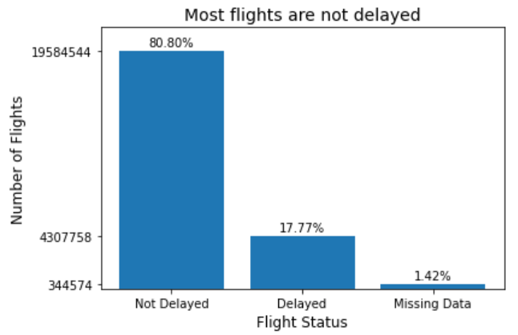
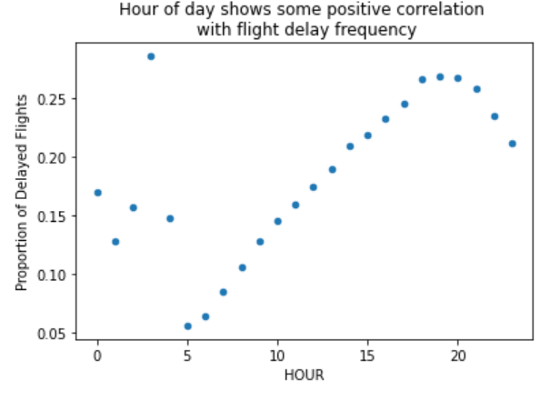
EDA: FLIGHTS
Notes:
Note: graphs cover 2015-2018 flight data only
[JEFF]
For our EDA we began by looking at our label (DEL15) for flights from 2015 to 2018. We found an unbalanced dataset, with the majority of flights being on time. To address this, we are experimenting with class weights and undersampling.
To address this, we are looking into oversampling the minority class, undersampling the majority class, or using weights. We haven’t made a final decision yet, but we’re looking into these options.
As well, we found that flights later in the day tend to be delayed more frequently. This could be the result of delay propagation, which is not surprising since delayed flight arrival is a common cause for delayed departure.
—---
Target class is unbalanced
Flights later in the day tend to be more delayed
Flight delays tend to grow towards the end of the day

Slide 7
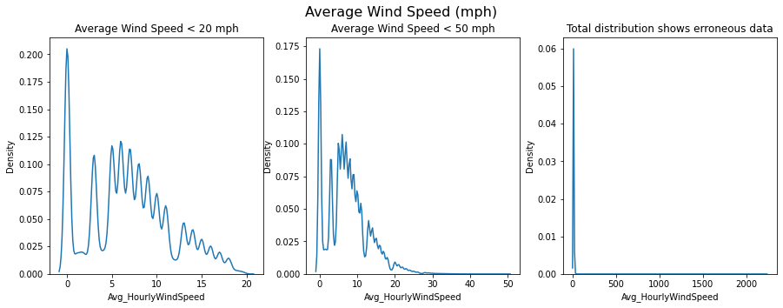
EDA: WEATHER
Notes:
[JEFF]
We looked at the distribution of our features.
Skewed
Transformations
Erroneous data (ex. Wind speeds >2000 mph do not exist)

Slide 8
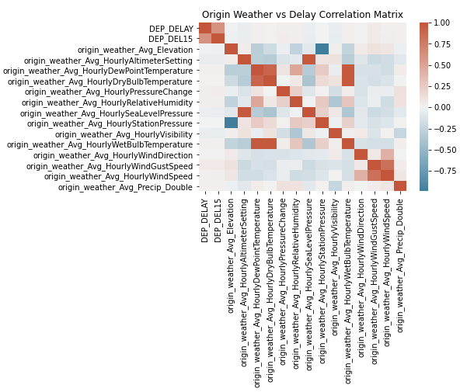
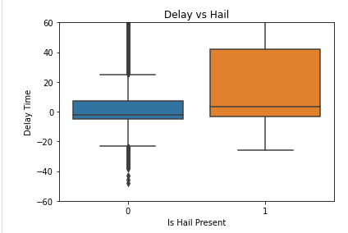
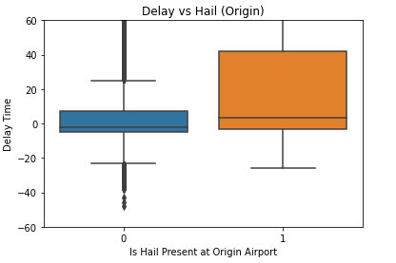
EDA: COMBINED DATASET
Notes:
[JEFF]
Jeff:
Once the weather and flight datasets were joined we began looking at correlations between delay and weather features, as seen in this correlation matrix. We were able to identify several weather features that are highly correlated with each other. We will utilize this information when we begin looking at features importance and we start dropping features. As you can see there is no strong correlation between numeric weather variables and our label (Dep_DEL15)
We also began looking at our binary weather variables versus delay time and were able to see several trends. One of these as can be seen on the right is with “the presence of hail at the origin airport”, which is not surprising. Again we will utilize this information to help in our feature importance analysis.
Next I will hand it off to Jenny to discuss data wrangling

Slide 9
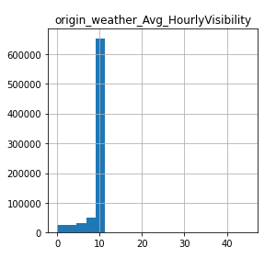
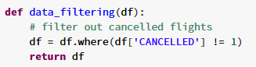
EDA: DATA WRANGLING
Column Reduction
Removed 112 columns
44 Diversion Columns
Information unknown 2 hrs before flight
Data Cleaning
Filter out cancelled flights
Null handling
Outlier identification
One-hot Encoded 8 Columns
Min/Max Scaled 26 Columns
Column Name | Null Count
DIV4_AIRPORT | 31434425
DIV4_AIRPORT_ID | 31434425
DIV4_AIRPORT_SEQ_ID | 31434425
DIV4_WHEELS_ON | 31434425
DIV4_TOTAL_GTIME | 31434425
DIV4_LONGEST_GTIME | 31434425
DIV4_WHEELS_OFF | 31434425
DIV4_TAIL_NUM | 31434425
Notes:
[JENNY]
Many steps in our data cleaning and wrangling process
~900 flights had NULL in DEP_DEL15 → these weren’t marked as canceled but had missing departure/arrival data
Jenny you can delete that code snippet if you think its dumb lol –joy
—------------
Jeff:
Because of challenges in implementing the new dataset, we spent less time than planned on EDA for the full dataset. We began by looking at correlations between delay and weather features, as seen in this correlation matrix. There is a strong correlation between delay time and the presence of hail at the origin airport, which is not surprising. Over the next weeks, we will perform additional EDA to get a better understanding of the data.
Because of challenges in retrieving the data, we haven’t had enough time yet to conduct a full EDA on the dataset
Started looking at correlation between delay and weather features
Early finding shows that xxxx is a good predictor of departure delay
Ex. hail at the origin airport

Slide 10
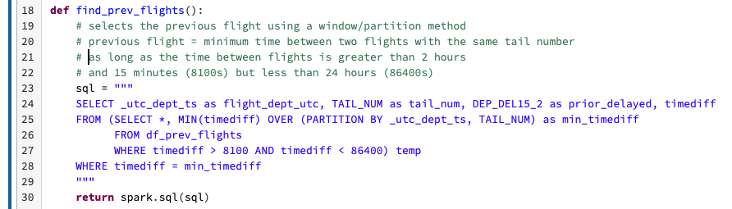
FEATURE ENGINEERING
Holidays
New columns to track if flight date is on a US holiday OR within 5 days of a US holiday
Delay Frequency By Airline
Grouped airlines by frequency of delays (low < 17% delayed, medium, high >20% delayed)
Incoming Aircraft Delay
Joined dataset with itself using tail number to find delay of previous flight
Previous flight must be 2-24 hours before the current flight
Notes:
[JENNY]
After establishing baseline model, we can look into feature importance/how our model is doing and come back to feature engineering
Modeling and feature engineering as iterative process
Ex. explore nonlinear features/transformations
(ex. Page rank)
Note: new airlines will default as medium

Slide 11
CLASSIFICATION MODEL
Evaluation Metrics
Cross Validation
Models Under Consideration
CustomCrossValidation for Time Series
Block CV over Tiered CV
Logistic Regression
Random Forests
+ Regularization
+ Dimensionality Reduction
+ Handling imbalance
(1+β²) · (Precision · Recall)
F_{β} =
(β² · Precision + Recall)
β = 0.5
Notes:
[DANTE]
Model needs to be balanced, but the business consequences of a False Positive can be worse than those of a False Negative ⇒ Chose to give higher importance to precision than recall ⇒ F_beta (beta = 0.5)
Evaluating multiple cross validation strategies
Leaning towards a blocked CV approach, mostly to avoid data leakage when the same portion of the data is used both for training and test - more to come in next slide
Considering various classification models, including Logistic Regression (as a baseline), but most likely leaning towards Random Forest or some other non-linear model due to the non linear nature of the data
Obviously, doing work on regularization and model simplification to improve performance on generalizability
One important challenge that we are still working through is how to handle imbalance

Slide 12
J
F
M
A
M
J
J
A
S
O
N
D
2015
T1
T1
T1
T1
T1
T1
T1
T1
T1
T1
T1
T1
2016
V1
V1
V1
V1
V1
V1
V1
V1
V1
V1
V1
V1
2017
T2
T2
T2
T2
T2
T2
T2
T2
T2
T2
T2
T2
2018
V2
V2
V2
V2
V2
V2
V2
V2
V2
V2
V2
V2
Notes:
[DANTE]
Current approach ⇒ 2 folds, 2 years each, 1 train, 1 test

Slide 13
J
F
M
A
M
J
J
A
S
O
N
D
2015
T1
T1
T1
T2
T2
T2
T3
T3
T3
T4
T4
T4
2016
V1
V1
V1
V2
V2
V2
V3
V3
V3
V4
V4
V4
2017
T5
T5
T5
T6
T6
T6
T7
T7
T7
T8
T8
T8
2018
V5
V5
V5
V6
V6
V6
V7
V7
V7
V8
V8
V8
Notes:
[DANTE]
One way to increase the number of folds is to work on quarters or semesters, but we want to take into accoun seasonality (as this model does)
This is still using one year entirely for training and one entirely for testing - Is it a limitation?

Slide 14
J
F
M
A
M
J
J
A
S
O
N
D
2015
T1
T1
T1
T7
T7
T7
T2
T2
T2
T8
T8
T8
2016
V1
V1
V1
T3
T3
T3
V2
V2
V2
T4
T4
T4
2017
T5
T5
T5
V3
V3
V3
T6
T6
T6
T4
T4
T4
2018
V5
V5
V5
V7
V7
V7
V6
V6
V6
V8
V8
V8
Notes:
[DANTE]
This approach would provide the most heterogeneous view of the data
If it gets too complicated, it could be done by semesters instead of quarters

Slide 15
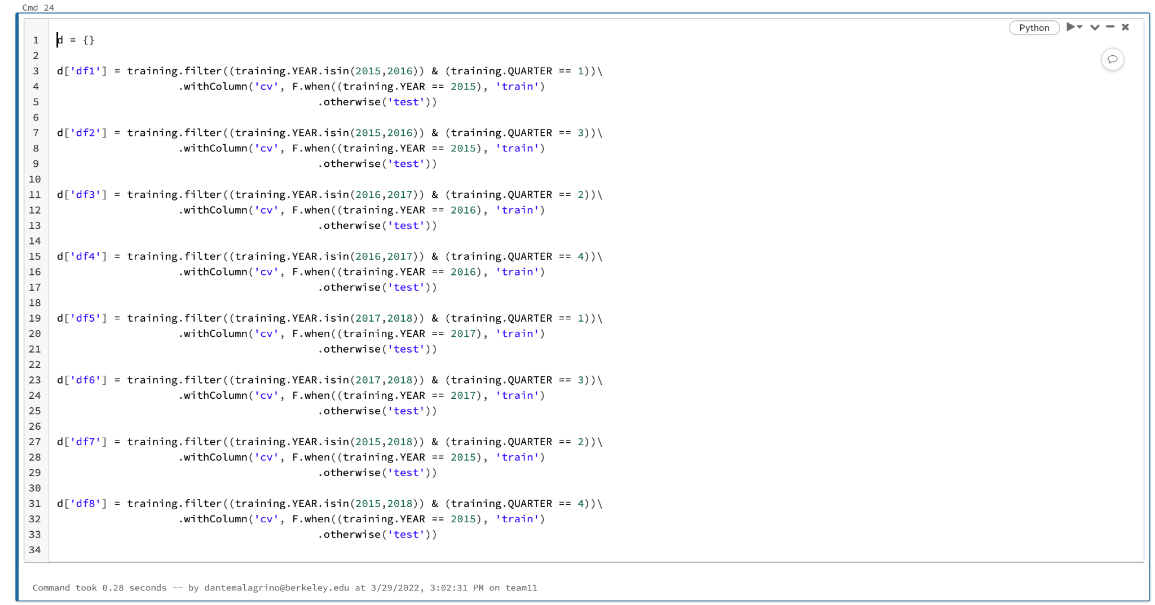

Slide 16
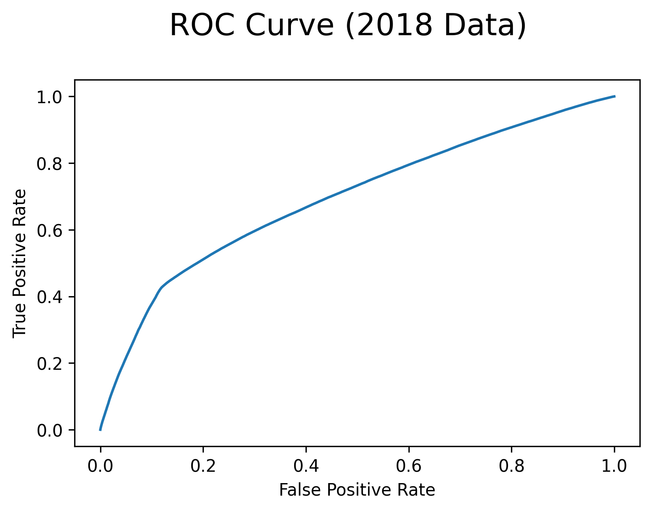
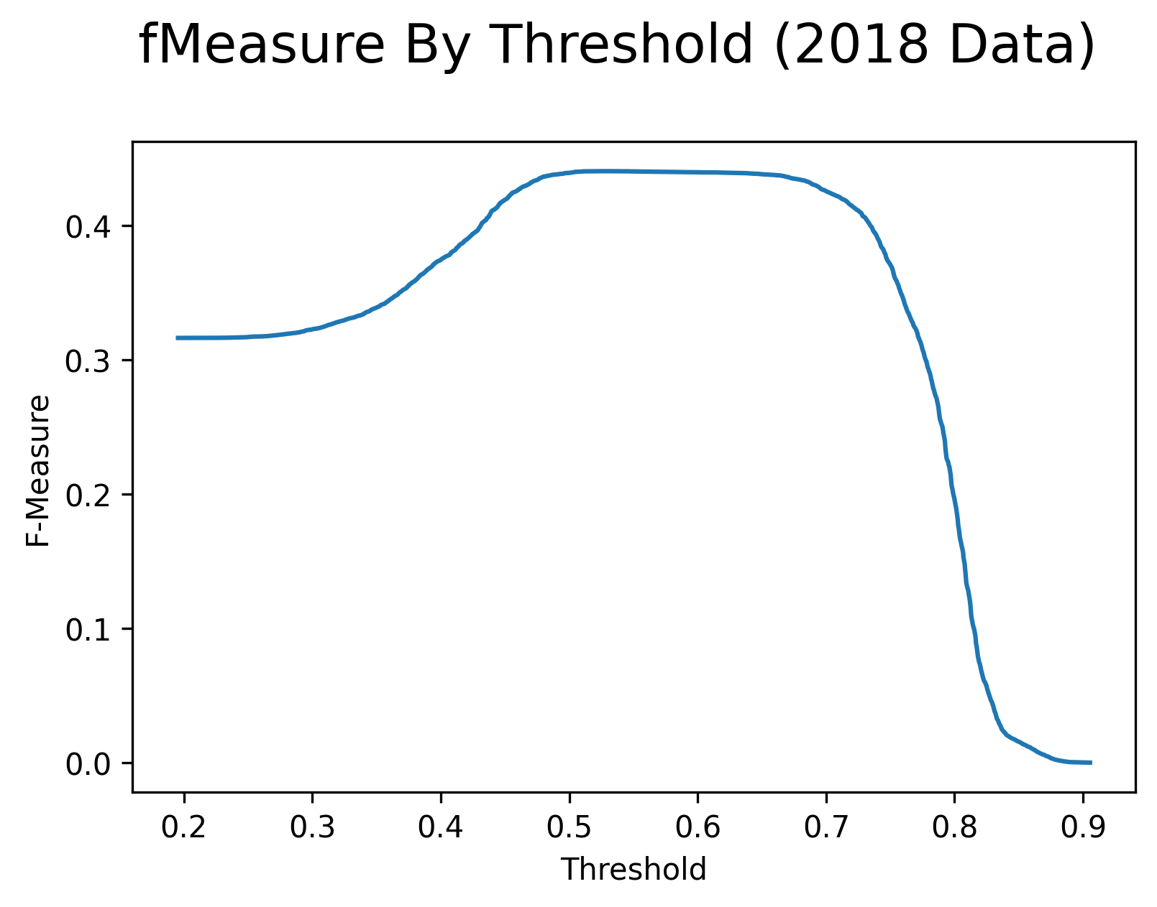
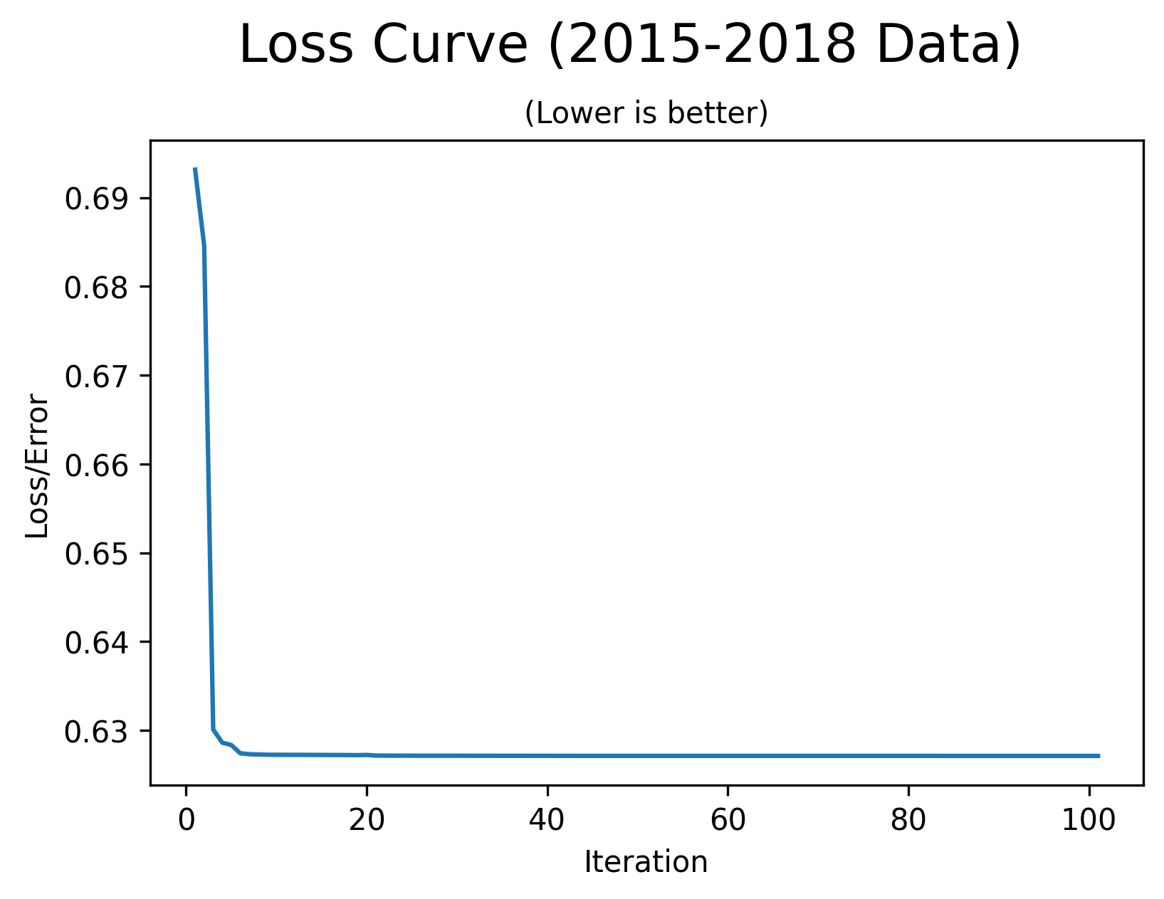
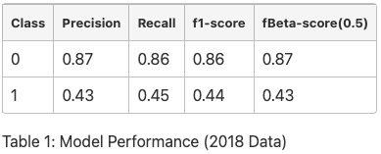
CURRENT RESULTS
Note: these results have not been updated to show CV
Notes:
[RAM]
Thanks Dante.
Here is a summary of our baseline logistic regression model. The ROC curve as well as the F-Beta score shows that we have more work to do. The loss curve tells us that the model has stopped learning. This gives us direction in terms of trying out new models, feature engineering and regularization.
Next, I would like to talk about the challenges we have overcome so far.

Slide 17
CHALLENGES
Ingesting data from a new data source
Performing EDA on new datasets
Optimizing for joining the big datasets
Data leakage issues with hourly weather aggregation
Handling time zones, time representation in data
Notes:
[RAM]
Ram:
The biggest challenge we faced was importing and ingesting 450 GB. We learned that limiting the amount of data earlier is better. Limiting to weather stations near airports reduced the ingestion time from 5 hours to 17 minutes. New data also meant we had to redo the EDA, which took time away from modeling work.
Next challenge was one of scale while join the data. We grouped both flights and weather data into 1-hour windows and filtered the weather stations, giving us a 25 minutes join time.
While doing this we inadvertently introduced data leakage which we had to fix.
[from guidelines] Performance & Scalability concerns, pipeline errors, debugging experiences
Importing about 450 GB of weather data for 7 years and manipulating it was very costly and time consuming, compounded by the inadvertent rookie mistakes. In the process, we learnt that reducing the data work much earlier in the process helps. Limiting the number of weather stations to those near airports of interest even before the ingestion process helped. We reduced the ingestion time from 5 hours to under 25 minutes.
Another challenge we had was that, by default, Spark was creating multiple 1 mb parquet files that lead to large read times. Repartitioning with year as partition key helped.
Spark's data type inference logic gave us a lot of grief. We ended up ingesting all fields as strings and applied our own conversion for the fields we need.
Grouping flights and weather into 24 windows per day (1 for the hour of the day), in addition to the reduced weather stations to look at, helped us achieve join time of about 25 minutes. The logic also includes a simple aggregation of weather data from potentially multiple readings within the hour.
Identifying potential data leakage issues with current hourly weather aggregation method
That was not easy to achieve. We had quite a few challenges. For example, we had to work with 450 GB of data, which presented challenges for importing and ingesting. We had to do a couple of iterations because of rookie mistakes.
The earlier you limit the amount of data you work with, the better.
We removed weather stations early on, which helped us implement the join in 25 minutes.

Slide 18
LIMITATIONS (to overcome)
& FUTURE WORK
Test different model types
Conduct additional feature engineering and implement dimensionality reduction
Explore alternate standardization methods
Currently dropping null values rather than imputing data
Outliers remain untouched in dataset
Notes:
[RAM]
Based on what we have done so far, we have a plan for the next few weeks. With that we would like to conclude and open it up for question and answers.

Slide 19
THANK YOU

Slide 20
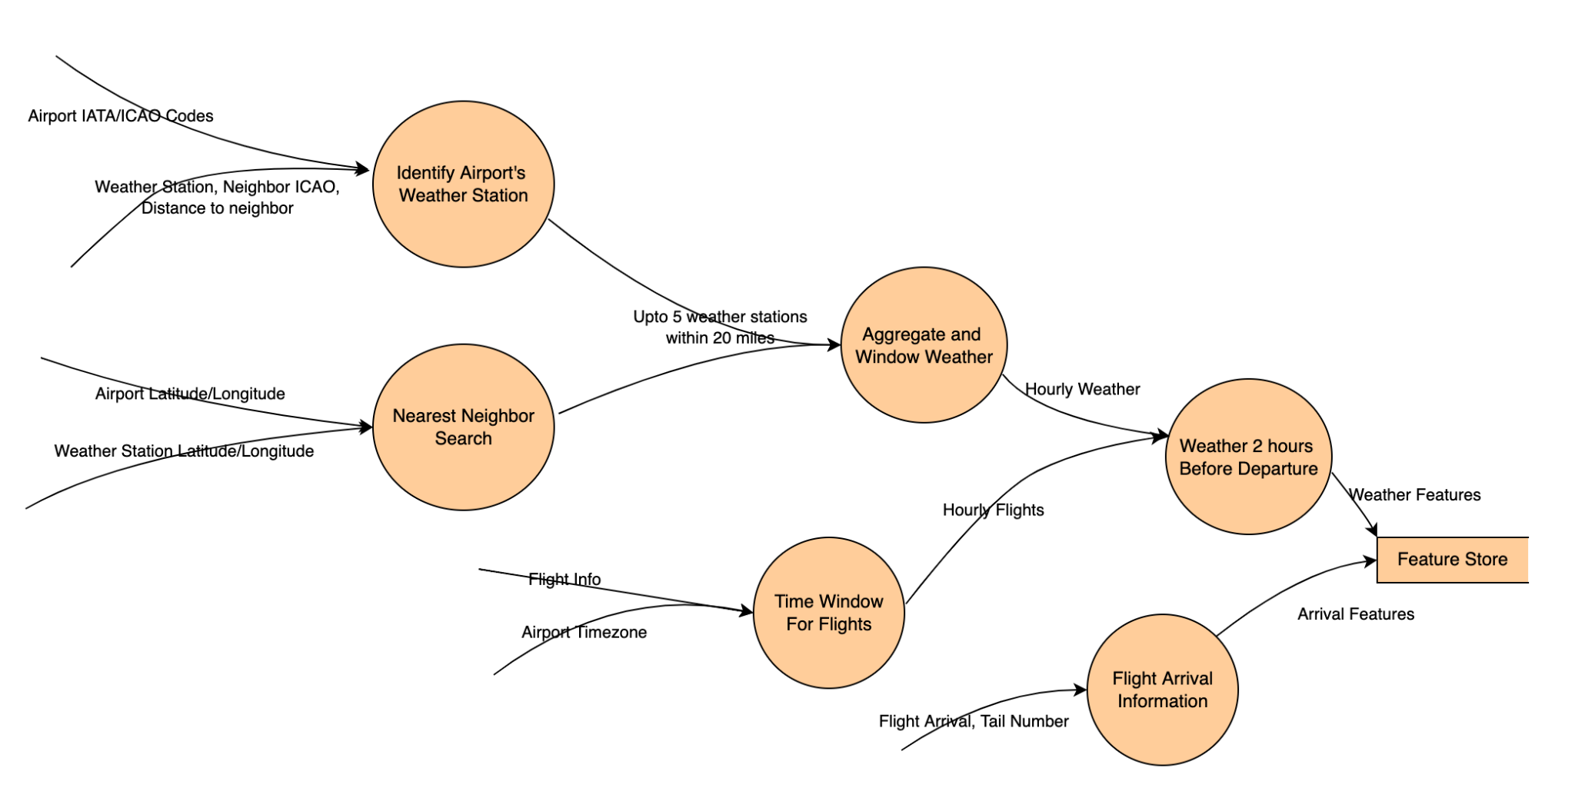
Datasets
Notes:
[RAM]
This graphic illustrates how we will be joining multiple datasets. Our combined dataset has over 30 million flights between about 370 airports in the United States and 40 million weather observations from 700 weather stations.
Key points (for any questions):
Addressing Scale
12,000 weather stations to 700 weather stations near 372 airports.
630 million observations to about 40 million observations.
31 million flights between 372 airports
Joins
IATA <-> ICAO, IANA for TZ.
Ball Tree based KNN using latitude and longitude. Upto 5 weather stations within a 20 mile radius.
Date + hour of day as partition key.

